Slide 1


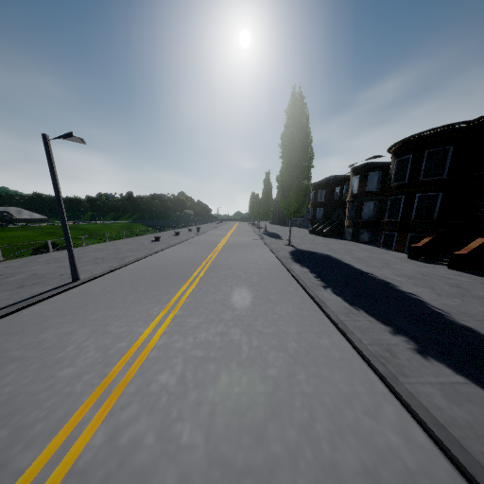
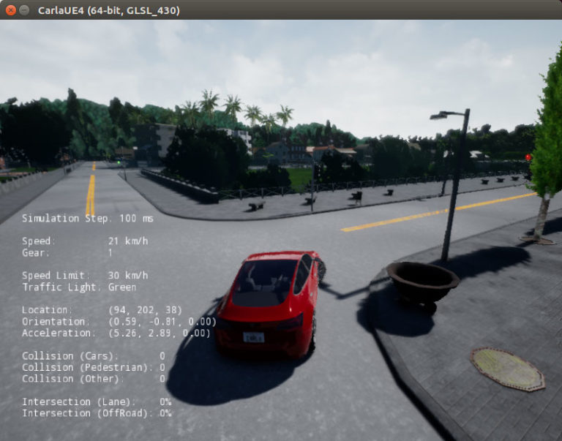
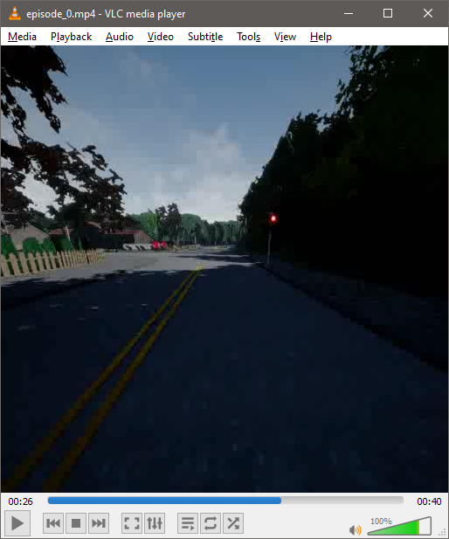
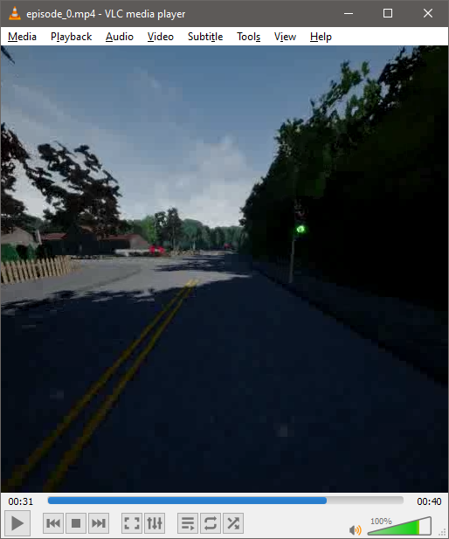
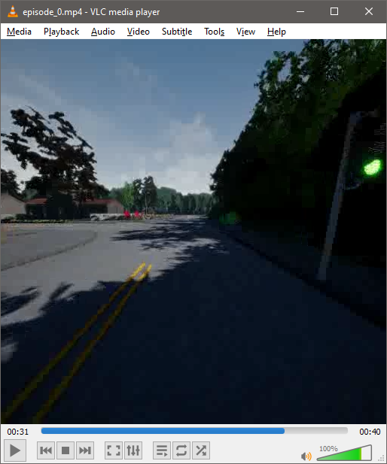
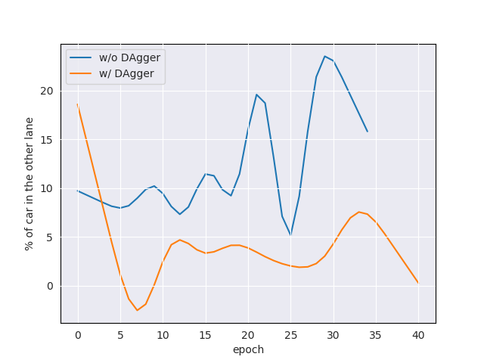
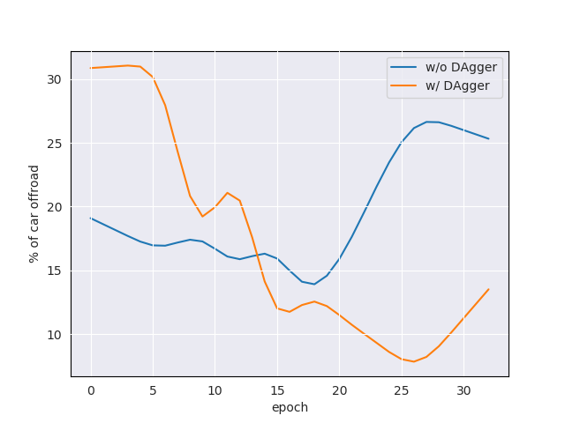
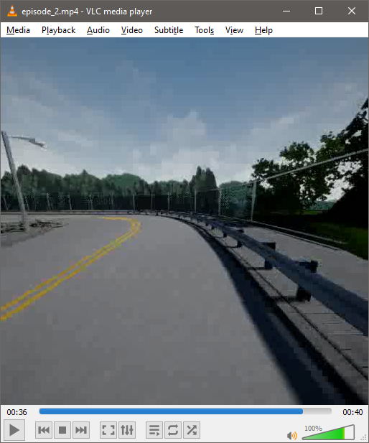
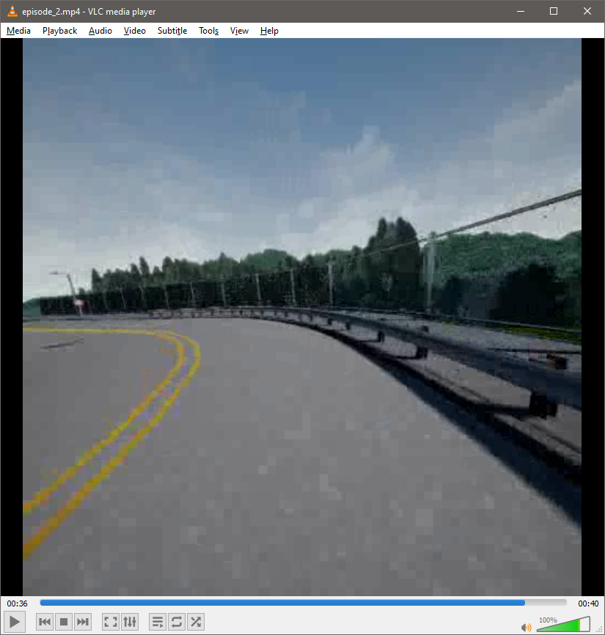
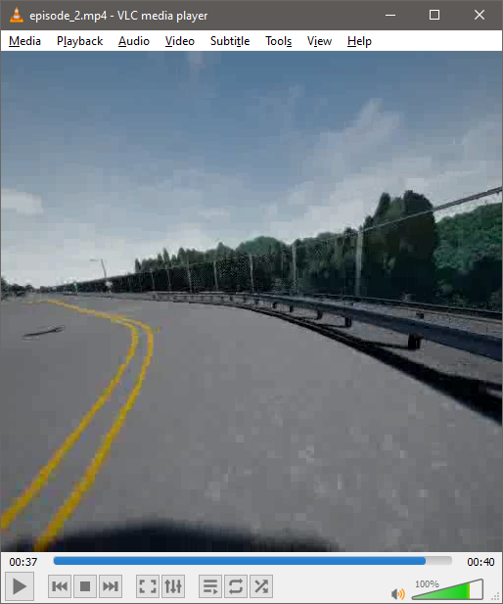
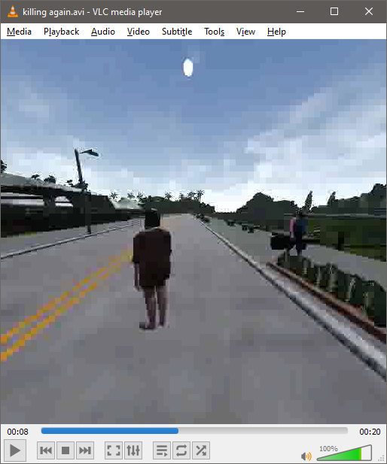
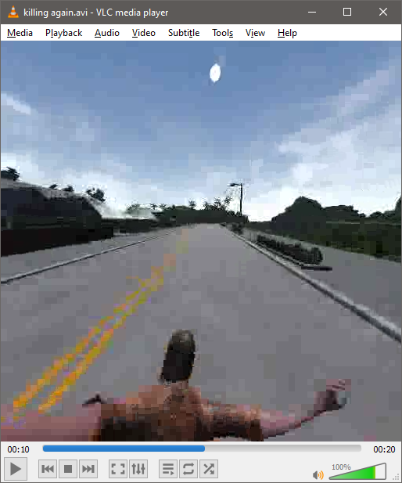
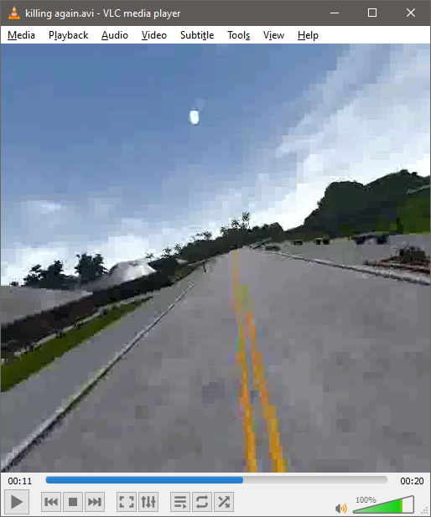
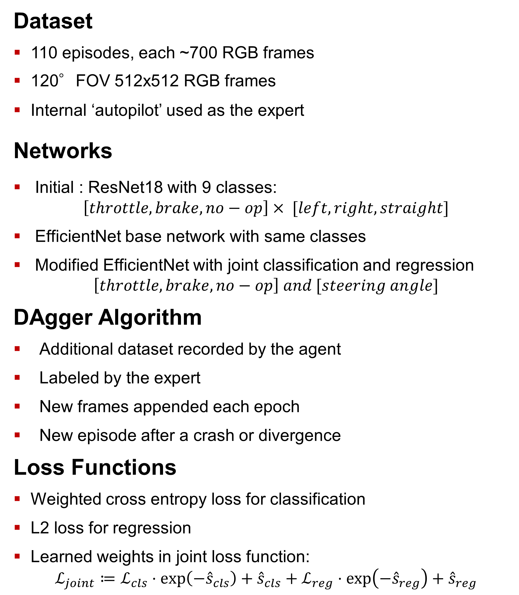
Imitation Agent for CARLA Simulator M. Hosein Bahadorani
Project Goals
Heading correction in straights
Steering in junctions and curved streets
Collision avoidance in complex dynamic environment with other cars and pedestrians
Correct behavior w.r.t traffic lights
Dataset
110 episodes, each ~700 RGB frames
120°FOV 512x512 RGB frames
Internal ‘autopilot’ used as the expert
Networks
Initial : ResNet18 with 9 classes: $\left[throttle, brake, no−op\right]× [left, right, straight]$
EfficientNet base network with same classes
Modified EfficientNet with joint classification and regression
$$\left[throttle, brake, no−op\right] and [steering angle]$$
DAgger Algorithm
Additional dataset recorded by the agent
Labeled by the expert
New frames appended each epoch
New episode after a crash or divergence
Loss Functions
Weighted cross entropy loss for classification
L2 loss for regression
Learned weights in joint loss function:
$$ℒ_{joint}≔ℒ_{cls}⋅\exp\left(−{\hat{s}}_{cls}\right)+{\hat{s}}_{cls}+ℒ_{reg}⋅\exp\left(−{\hat{s}}_{reg}\right)+{\hat{s}}_{reg}$$
Training procedure
Training set
DAgger frame collection
DAgger training
Simulation in CARLA
Validation set
Training Parameters
Learning rate: 5e-4
Batch size: 32
Epochs: 30
DAgger frames: 1600/epoch
History: 3
Simulation: 10 episodes, 600 frames
Transforms: color jitter, resize(256), normalization
Customizations
Input layer changed to accommodate history
Output layer replaced with two separate FC layers
Classification layer fed to cross entropy loss
Regression layer passed through tanh activation
Experimental Results
Agent successfully drives in straight lanes
Agent mostly avoids collisions
Agent steers according to the training data
https://github.com/hos-b/image-carla

